Slide 1




Real-Time Tweet Sentiment Analysis
This presentation will introduce our Real-Time Tweet Sentiment Analysis project, highlighting its objectives, methodologies, and potential impact.

Slide 2



02
Project Overview
OUR GOAL
Sentiment Analysis Overview
Why Analyzing Tweets

Slide 3




Methodology
Data Collection
Preprocessing
Model Selection
Gather relevant data from diverse sources.
Tokenization, lemmatization, and cleaning data.
Using Hugging Face Transformers (cardiffnlp/twitter-roberta-base-sentiment).
03
www.reallygreatsite.com

Slide 4



04
Model
Development
Key Libraries
Pandas
SpaCy
Hugging Face Transformers
TensorFlow
Text Cleaning
Sentiment Prediction
Real-Time Processing

Slide 5


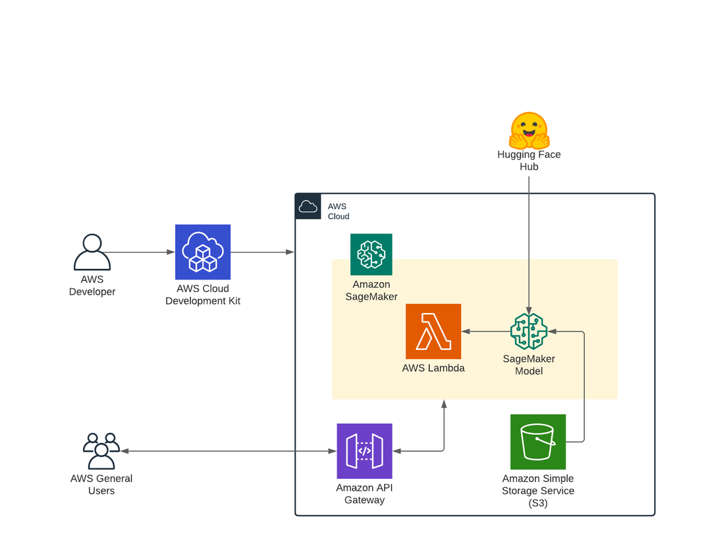
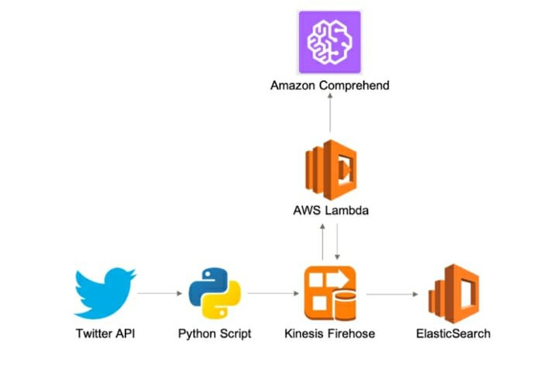

05
AWS Services
Plan A
Plan B

Slide 6




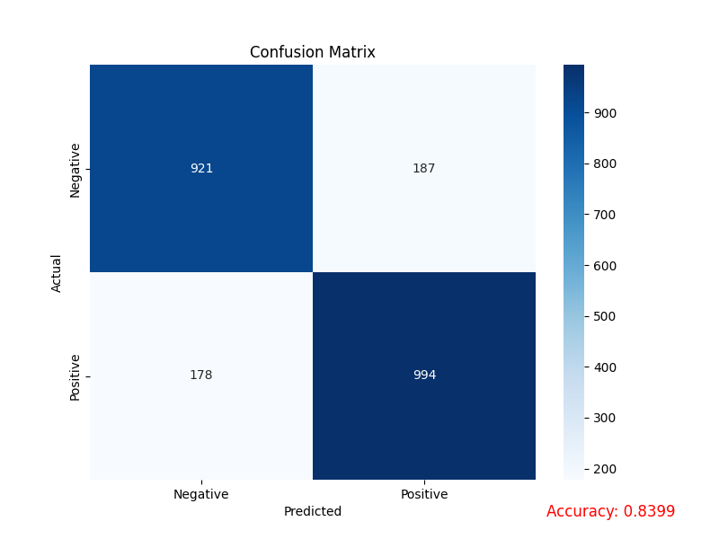
Visualization
06

Slide 7



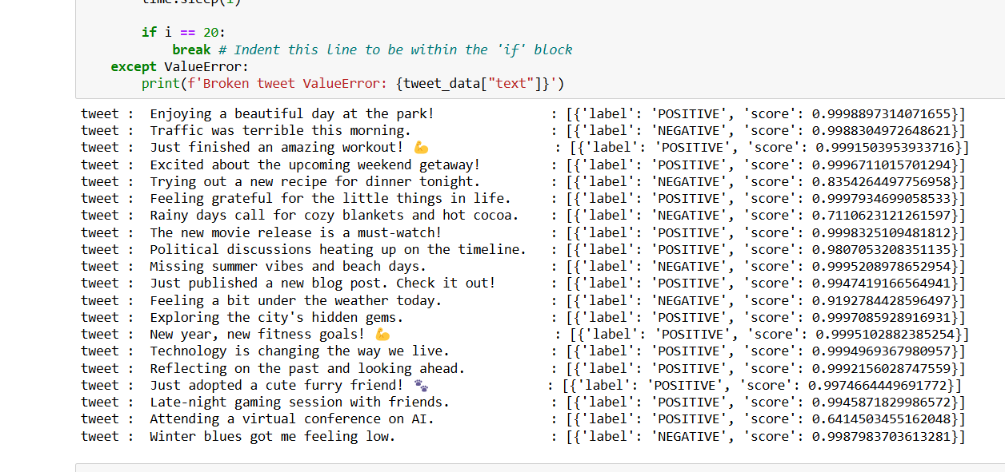
Result and Predictions
07

Slide 8


Q&A

Slide 9





Thank You!
Get in touch with us

